Slide 1
Advanced Security Monitoring Tools
Cybersecurity
Lesson 19.2

Slide 2

Learning Objectives
By the end of today’s class, you will be able to:
Differentiate between various advanced security monitoring solutions, such as SOARs, UBAs, and UEBAs, and determine which is most appropriate for a specific security situation.
1
2
Understand how knowledge of SIEM software and Splunk is valued in the information security job market.
3
Continue learning about Splunk with free Splunk training courses.

Slide 4
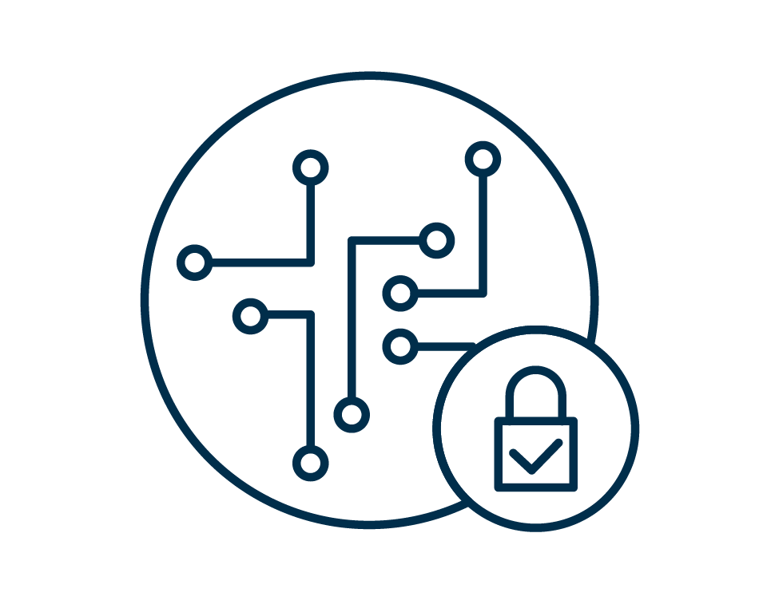
Advanced Security
Monitoring Tools

Slide 5
Introduction to Advanced Security Monitoring Tools
Today, we’ll learn about other information security products used by security organizations.
We will introduce and work towards the Splunk Fundamentals certification.
We’ll introduce Splunk’s SIEM product, Enterprise Security, and explore several other security products available in the marketplace.
First
Next
After the break
Finally
We’ll focus on security careers relevant to the knowledge and tools learned in the last five classes.
We’ll introduce the final project, the bootCon presentation.

Slide 6
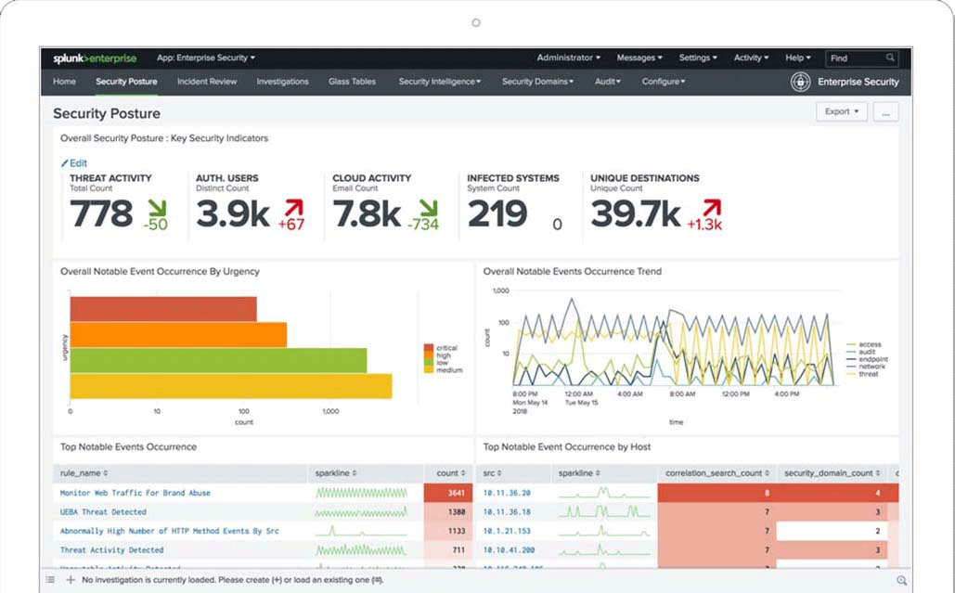
Splunk Enterprise Security
In the past five classes, we covered many of Splunk’s capabilities and add-on applications.
The Splunk SIEM product, Splunk Enterprise Security (ES), is one of the most popular add-on products for security professionals.
(splunk.com)

Slide 7
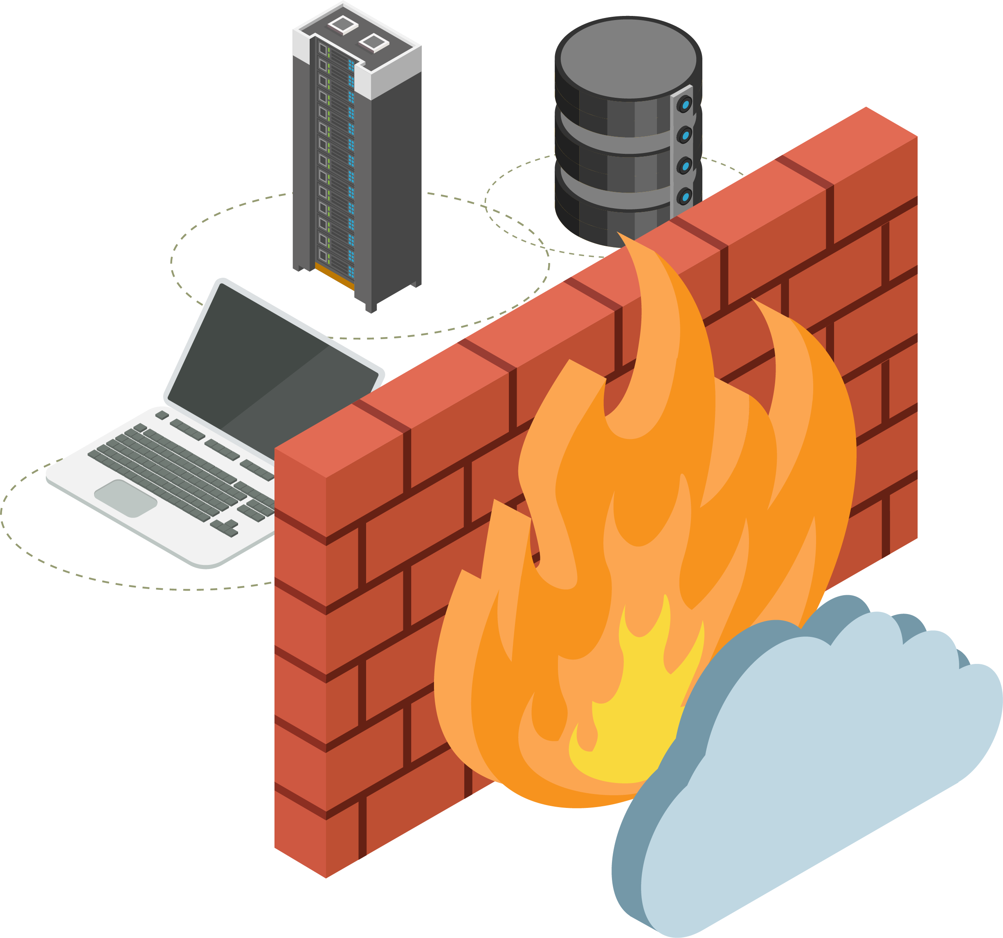


Splunk ES
Splunk ES is a SIEM product that provides security professionals with insights from machine-generated data, such as:
01
02
03
Network devices
like routers and firewalls
Endpoint devices
like antivirus solutions
Vulnerability management systems
like Nessus
Notes:
Shutterstock_792833623 shutterstock_693068344 shutterstock_693068344.png

Slide 8

Splunk ES is one of the most popular add-on products for security professionals, as it
has pre-built dashboards, reports, and built-in features.

Slide 9
Splunk ES
Splunk ES features allow you to:
Identify, prioritize, and investigate security events.
Gain insights into security events.
Monitor the status of a security environment.
Audit security events.
Navigate these tasks with a pre-built, easy-to-use interface.

Slide 10
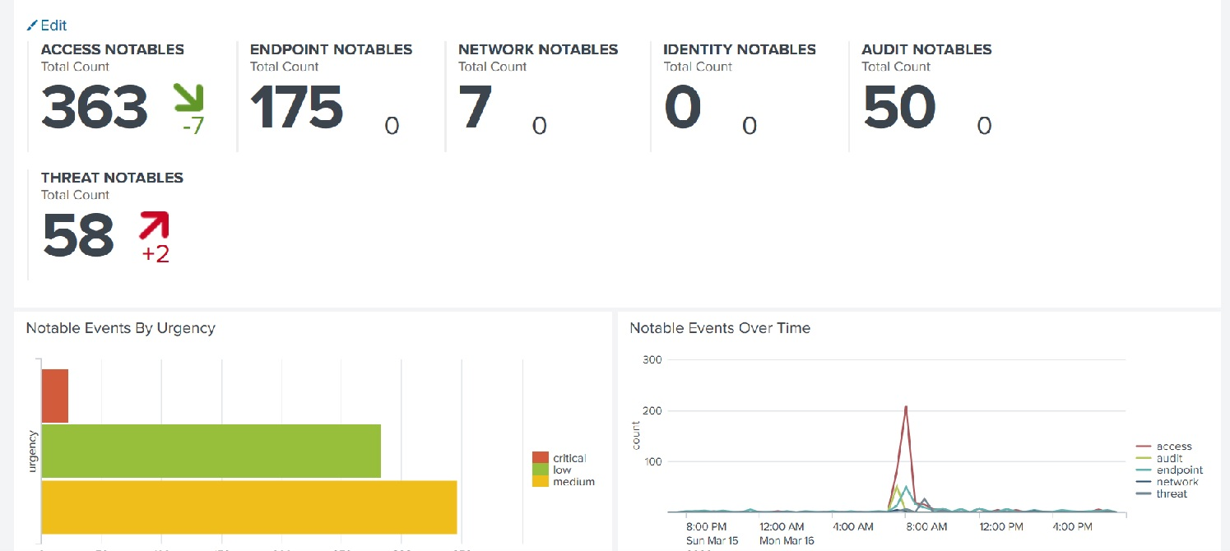
Splunk ES
Example of a basic Splunk ES dashboard:

Slide 11

Advanced security monitoring solutions provide additional benefits such as machine learning, artificial intelligence, automation, and response.
Notes:
shutterstock_650430397

Slide 12
Advanced Security Monitoring
The most popular advancements in the information security industry include:
UBA | User behavior analytics
UEBA | User and entity behavior analytics
SOAR | Security orchestration, automation, and response
XDR | Extended detection and response

Slide 13
UBA is a security monitoring tool that uses machine learning, artificial intelligence, and data processing to detect abnormalities in user activity.

Slide 14
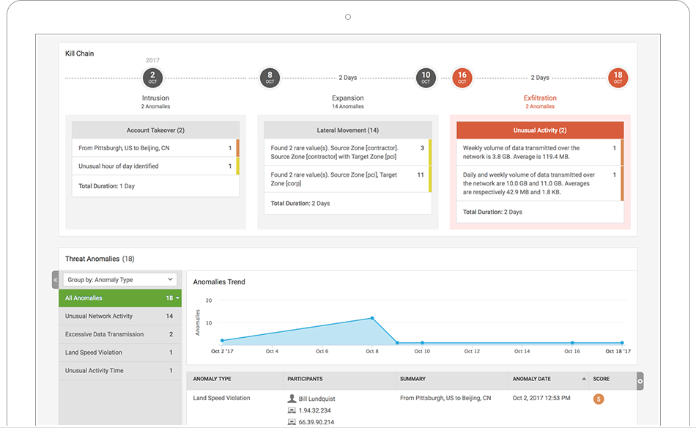
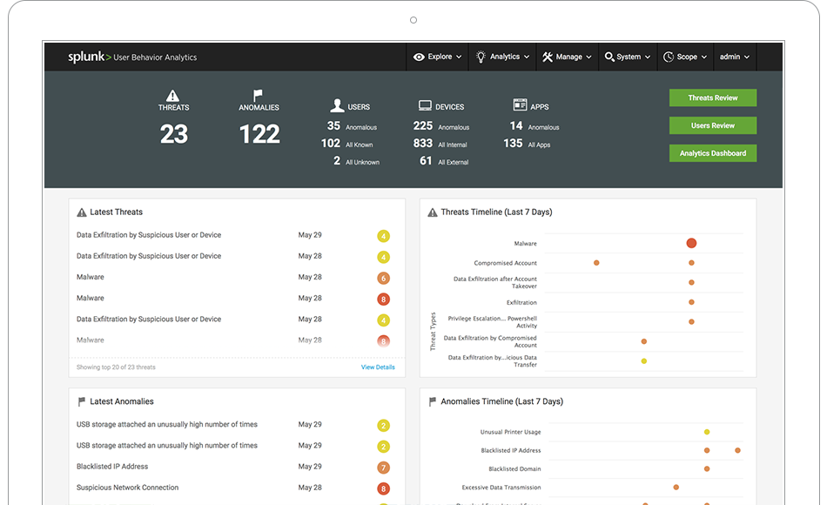
UBA
UBA gathers information about typical user behaviors and creates baselines.
(splunk.com)

Slide 15
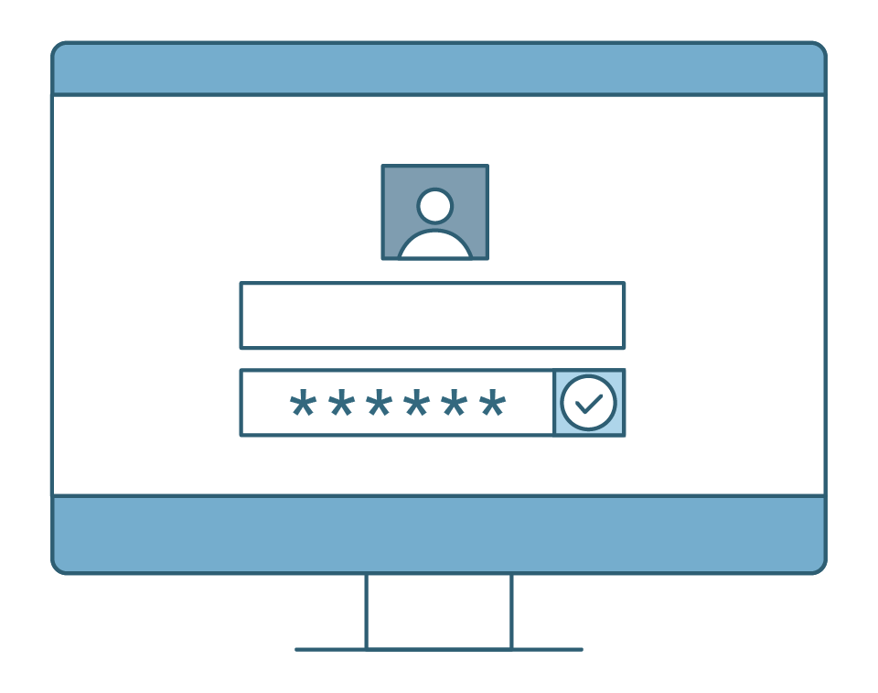
UBA
An example of UBA in action:
UBA gathers information on the servers and systems that a user accesses, as well as when and how frequently they do so.
It create alerts for when a user’s activity deviates from typical behavior
If a user usually only logs onto a server between 9am and 5pm Monday through Friday, UBA would create an alert if the user logged in on at 2am on a Saturday.

Slide 16
UEBA is a security monitoring tool similar to UBA, except it extends its monitoring to other "entities."

Slide 17
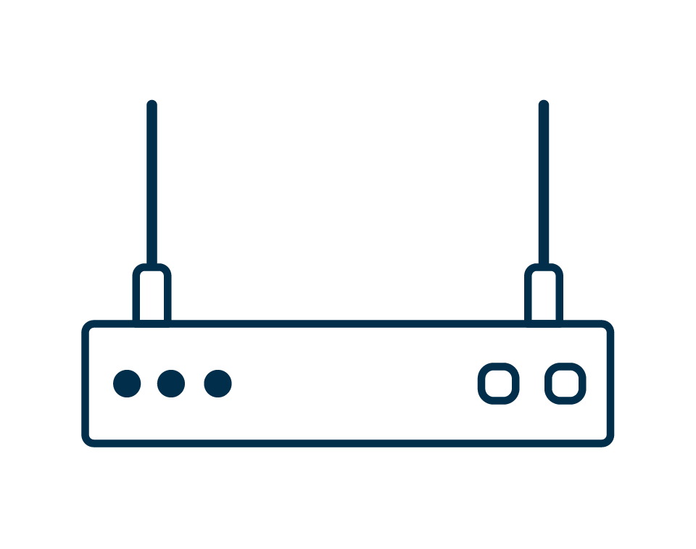
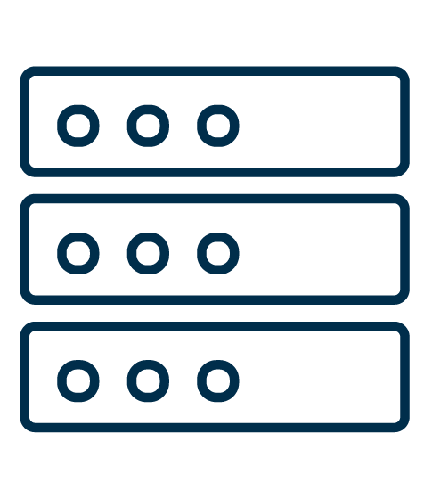

UEBA
Entities can include:
Routers
Servers
IoT Devices

Slide 18
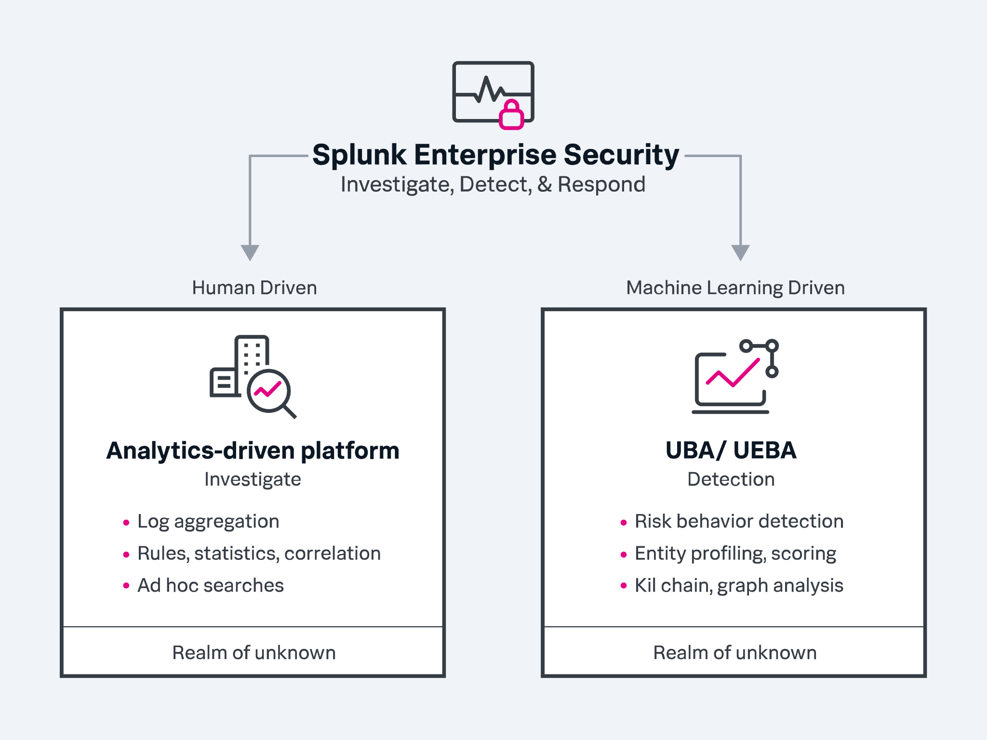
UEBA
UEBA looks at typical user and entity behaviors and creates alerts when they display unusual activity.
(splunk.com)

Slide 19
SOAR, comparable to a SIEM, automates security processes and responds to security incidents.

Slide 20

SOAR
Automating security processes examples:
Creating logging
Assigning priorities to security incidents

Slide 21
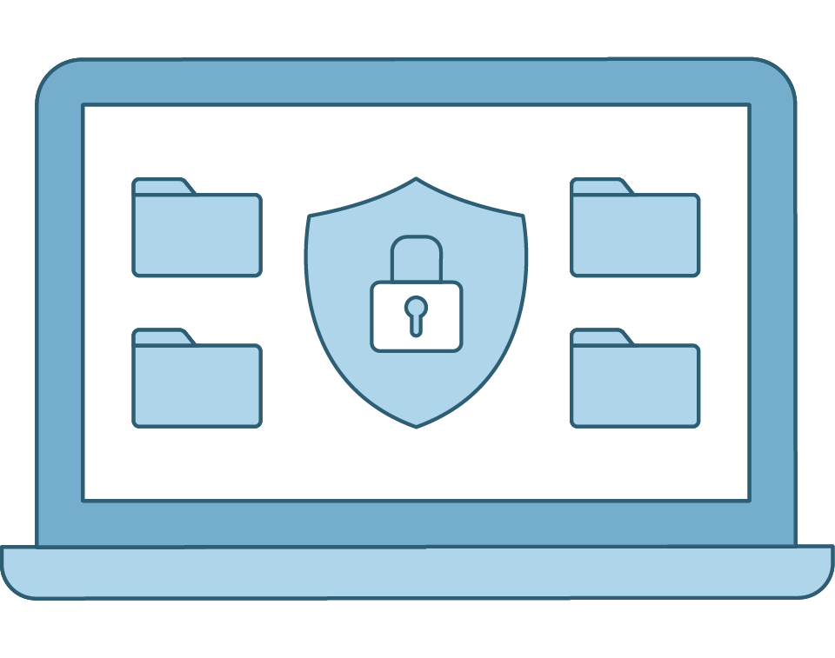
SOAR
Responding to security incidents examples:
Launching security investigations
Mitigating threats

Slide 22

Similar to a SIEM, SOAR gathers machine data from multiple entities and analyzes the data for security events.
Notes:
shutterstock_1208815192

Slide 23
SOAR uses playbooks that detail the processes and response actions for specific events.

Slide 24

SOAR
This diagram illustrates how using SOAR playbooks can decrease incident response time. Playbooks are uniquely designed and configured by each organization.
BEFORE
automation
TOTAL TIME
start to finish
3–5 mins
3–5 mins
10 mins
per URL
30 mins
per scan
3–5 mins
5–10 mins
5 mins
5–15 mins
75 minutes
Create a ticket.
Check URLs and other IoCs.
Analyze suspicious
activity.
Scan user endpoint for malware.
Search for similar emails.
Block incoming mail.
Alert employees.
Blackhole DNS.
2 minutes
AFTER automation
Human decision
Notes:
Avatar AdobeStock_229758328

Slide 25
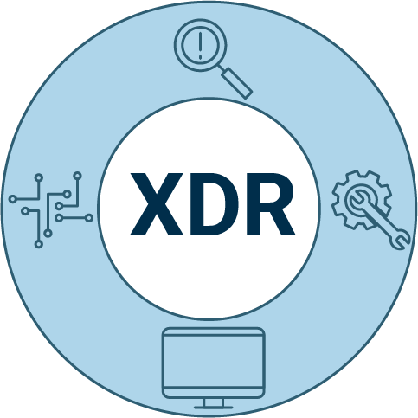
XDR
Extended detection and response
XDR offers advanced detection, rapid response, and intuitive automation.
It provides improved cross-domain threat hunting and forensic investigation capabilities.
It lacks the log management, retention, and compliance capabilities of SIEM.

Slide 26

Advanced Security Monitoring Tools
OMP management has approved a larger budget for the SOC to enhance its security monitoring.
You are tasked with researching several SOAR, UBA, and UEBA vendors to provide a summary to your management about the products you are recommending.
20 Minutes

Slide 29

Splunk Careers

Slide 30

Now, we’ll explore careers and certifications related to the Splunk knowledge and tools learned over the past five lessons.
Notes:
AdobeStock_143498286_Splunk

Slide 31

Splunk experience is a desirable qualification for many information security positions.
Notes:
shutterstock_669170791

Slide 32
Splunk Careers: InfoSec Positions
SOC analysts | SOC analysts work in a security operations department alongside security engineers. Their positions involve detecting, containing, and potentially remediating information security threats. Most SOC analysts use SIEM products, such as Splunk ES, to monitor their environment.
Cyber threat analysts | Cyber threat analysts analyze an organization’s networks and applications to protect organizations from cybercriminals. Cyber threat analysts often use Splunk products to make predictions about cybercriminals and their potential attacks.
Application security engineers | Application security engineers Use Splunk to fix web and mobile application vulnerabilities. AppSec engineers use Splunk to analyze their application logs to assist with creating and testing their remediation.
Network security administrators | Network security administrators use products like Splunk to monitor suspicious network traffic, such as DDoS attacks. They can use the findings from Splunk logs to mitigate and prevent future attacks.
Incident response managers | Incident response managers use Splunk to monitor the status of ongoing security investigations when an incident has occurred.

Slide 33


Splunk Careers: InfoSec Positions
Some positions
(such as SOC and threat analyst) may
use Splunk products as part of their primary responsibilities.
Other security
positions (such as AppSec administrators)may only use Splunk for a small portion
of their tasks.
Either way, understanding how to use Splunk is a valuable skill for InfoSec professionals.

Slide 34
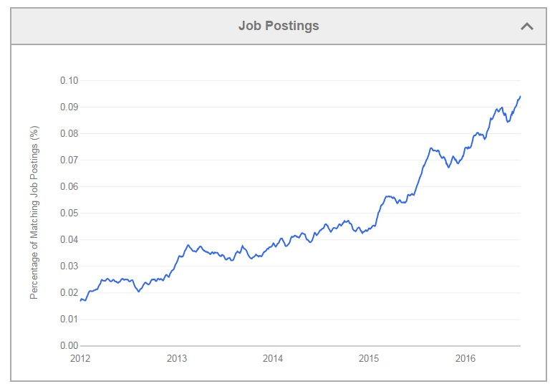
Splunk in InfoSec Careers
Splunk is already a required skill in many roles, and the industry demand is increasing every year.
(Source: edureka!)

Slide 35
Splunk Careers
In this activity, you will search several job sites for Splunk-related careers and answer questions about each position.
15 Minutes

Slide 39

SIEM Certifications

Slide 40
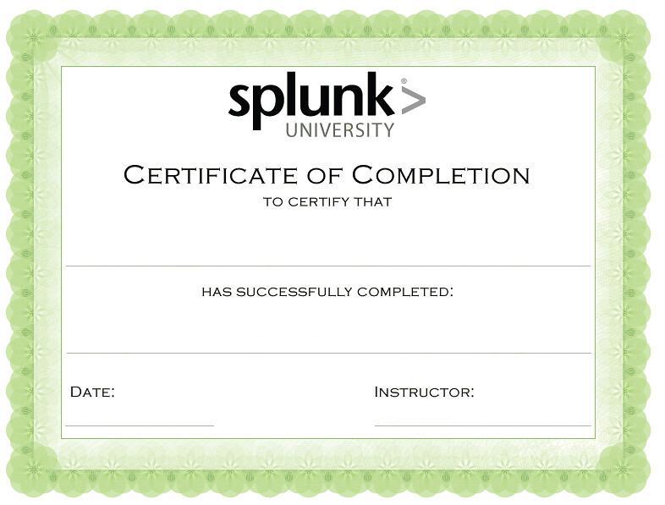
Splunk Certifications
Having a certification can help a cyber professional acquire a new position, receive a promotion, and attain networking opportunities with professionals who have similar certifications.
Name Here
Date Here
First Name, Last Name

Slide 41
Splunk offers several certifications of varying skills.

Slide 42




Splunk Certifications
Splunk offers many certifications for a variety of skill levels:
Splunk Core
Certified User
Splunk Core Certified
Power User
Splunk Core Certified Advanced Power User
Entry-level certification
that demonstrates a user’s basic ability to use the
Splunk software
Demonstrates a user’s foundational skills with Splunk’s core software, plus more complex skills, such as creating calculated fields and data models
Demonstrates a user’s capability to design reports, complicated searches,
and dashboards

Slide 43
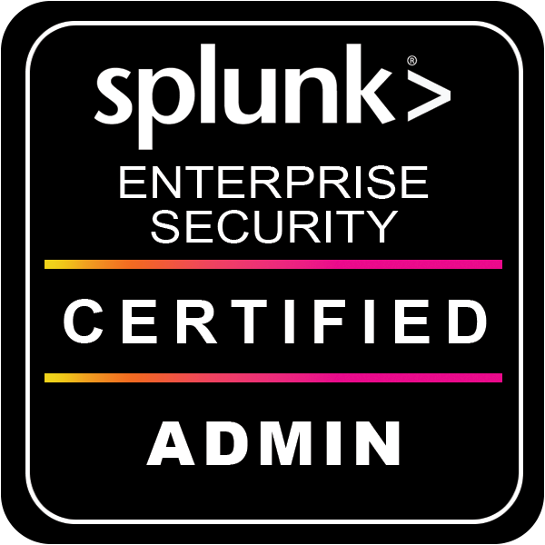

Splunk Certifications
Splunk offers many certifications, for a variety of skill levels.
Splunk Enterprise
Certified Admin
Splunk Enterprise
Certified Architect
Splunk Enterprise
Security Certified Admin
Focuses on an individual’s ability to support daily administrative tasks using Splunk ES
Focuses on a Splunk administrator’s role supporting advanced troubleshooting, configurations, and deployments in Splunk ES
Focuses on a Splunk administrator’s role to support installation, advanced troubleshooting, configurations, and deployments in Splunk ES

Slide 44
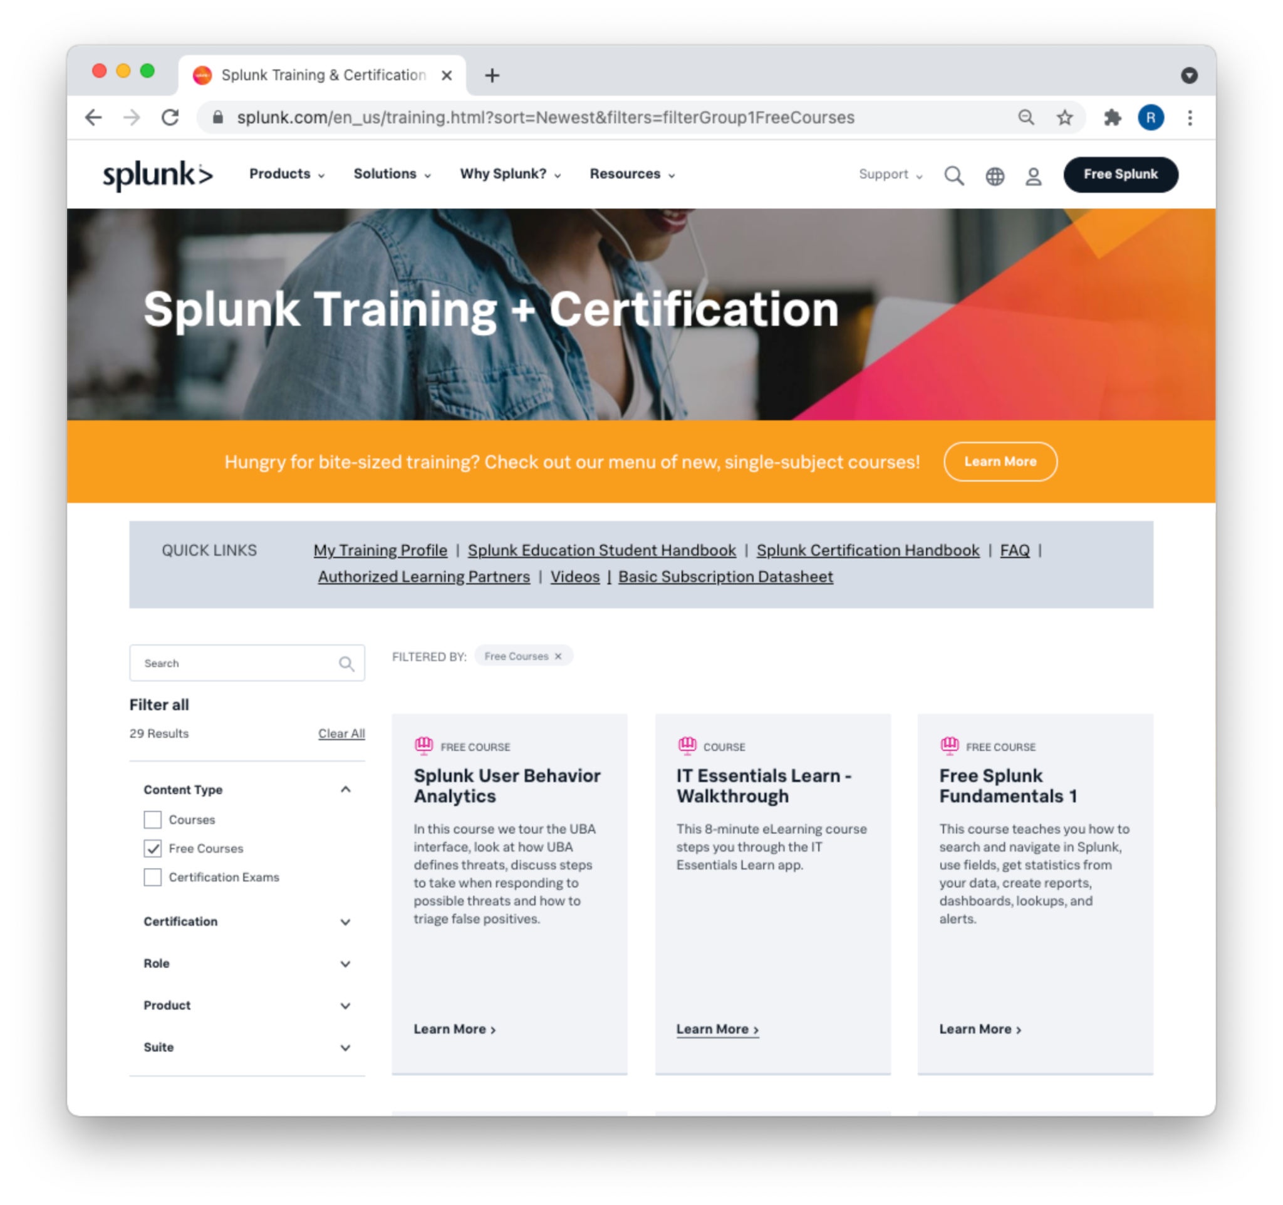
Splunk Certifications
Like for many certifications
in the InfoSec field, training for Splunk certifications is expensive.
Fortunately,
Splunk offers
many single-subject courses for free.
(splunk.com)

Slide 45
Splunk Certification
In this activity, you’ll register for a Splunk account and begin single-subject courses.
60 Minutes

Slide 47

Activity: Splunk Certifications
Resources for taking the Core Certified User certification exam:
1
Splunk: Core Certified User certification
2
Splunk: Journey to getting certified (video)
3
Splunk: Exam registration tutorial
4
Pearson VUE: Exam registration
5
Splunk: Certification study guide

Slide 48
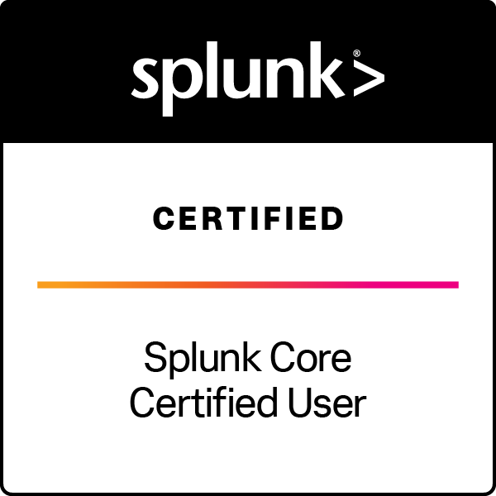

Splunk Certifications
If you are interested in continuing your education towards a Splunk Core Certified User certification:
You can access additional learning courses in your
own time.
You can take the Splunk Core Certified User exam to earn a Splunk certificate.
Notes:
AdobeStock_266184570_three

Slide 50

Overview of Remaining Projects
And Introduction to BootCon

Slide 51
Project Weeks
You will complete two more projects in this course:
Defensive Security Project
2. Final Project: BootCon
This project will occur at the end
of the Defensive Security module and will incorporate everything you learnt in this module.
We’ll cover the details next week.
This project will occur in the last week of class.
We’ll get an overview now so that you can begin brainstorming and preparing.

Slide 52
Cybersecurity Research Presentations
Cybersecurity professionals commonly present the following to their peers:
1
Security research they’re conducting
2
Newly discovered security vulnerabilities of products, devices, software, or hardware
3
Demonstrations of the “hacks” that will exploit these vulnerabilities
4
Mitigations to protect against these vulnerabilities

Slide 53

These presentations often occur at security conferences, trade shows,
and other industry events.
Cybersecurity professionals commonly attend these events to remain up to date with new technological developments and techniques.
Notes:
shutterstock_2064711338

Slide 54
BootCon Presentations
Similarly, you will have an opportunity to showcase your skills during bootCon.
1
On the last day of class, we will hold a cybersecurity conference called bootCon.
2
Each student will have an opportunity to showcase the skills they learned during the bootcamp with a presentation.
3
If you elect to present as a group, every group member must participate in the presentation.
Most cyber professionals present at conferences when they’ve found a new vulnerability. However, for bootCon presentations, it is acceptable and recommended that you recreate a finding that has already been discovered.
4

Slide 55
A bootCon presentation is NOT a research paper.

Slide 56

While research
will be required,
all presentations
must be tangible
and demonstrable.
A demonstration
can either be:
Conducted in person
A prerecorded video
that accompanies
the presentation
(if a live demonstration
isn’t practical)
Notes:
shutterstock_1703997142_presentation

Slide 57
BootCon Presentations
Each bootCon presentation should fall into one of the following three categories:
01
02
03
Category
Exploiting a vulnerability of an IOT device
Developing code
or a program that can complete a cybersecurity task
Demonstrating how a cybersecurity tool that was not covered in class can accomplish a specific goal
Example
Hacking your personal Blu-Ray player
Developing a Python script that can automate an Nmap scan
Using SET to design a social engineering campaign

Slide 59

BootCon Rules and
Requirements

Slide 60
BootCon Rules and Requirements
You must submit a project summary to your instructor for approval.
The summary should be submitted with a Slack message by Week 22.
Your project summary should include:
1
The topic and title of your presentation
2
The end goal or vulnerability being exploited
3
A list of devices and/or technologies that will be used to accomplish the goal
4
A summary of how the devices and technologies will be used to accomplish the goal

Slide 61

BootCon Rules and Requirements
Under no circumstances may any aspect of your bootCon presentation be unethical or illegal.
You must:
1
Perform all hacks and tests in simulated environments.
2
Complete any network connections in your home and/or controlled environment.
3
Only perform IoT hacks on devices that you own.

Slide 62
BootCon Rules and Requirements
Presentations must have a goal whose achievement you can demonstrate.
For example:
Goal:
Cracking WEP wireless traffic from your home router
Demonstration:
Showing how you captured and cracked your wireless traffic
You can either conduct your demonstration live or record it and present it while you guide people through what took place.

Slide 63
BootCon Rules and Requirements
You must submit your presentation in the form of a Google Slides deck that, at a minimum, includes the following:
Cover slide | Presentation title and team member(s) presenting
Technical background | Explanation of why you selected the topic you are presenting Networking, cryptographic, or security concepts applied Research steps taken
Demonstration preview | Preview of the steps that you'll take in the upcoming demonstration
Demonstration | A live or recorded demonstration
Demonstration summary | A summary of the demonstration and any impact that it may have
Mitigation | Recommendations for mitigating against the attack that you just conducted (not required if your presentation isn't about an attack)

Slide 64
BootCon Rules and Requirements
01
02
You will present
your project on the
last day of class, and your total presentation time should be
7–10 minutes.
If you choose to
form a group of
2–3 students, presentation time
can be 5 minutes
per student.

Slide 65
BootCon Rules and Requirements
If you need ideas for your presentation, refer to the bootCon presentation guide, which contains:
1
Sample presentations
2
List of Kali Linux tools
3
List of IoT hacks
4
Videos of hacks presented at security conferences
Remember: Your project proposals are due in Week 22!

Slide 67
Designing Your Defensive Solution

